Slide 1


Unity Interface
C# in Unity & Programming Fundamentals
Collisions & Rigidbodies
The Basics
Character & Camera Movement
AI, NavMeshes, and A* Pathfinding Heuristic
Scriptable Objects & Saving/Loading Data
Rendering Pipelines & Post-Processing
Instructor: Vincent Aliquo vincent@hullabaloo-es.com
Class Repository: github.com/hullabaloo-vincent/iDTech

Slide 2
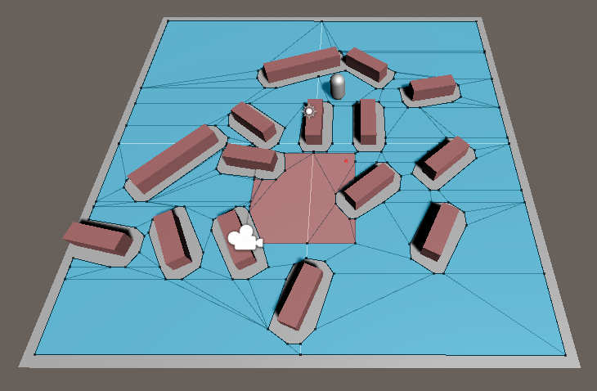
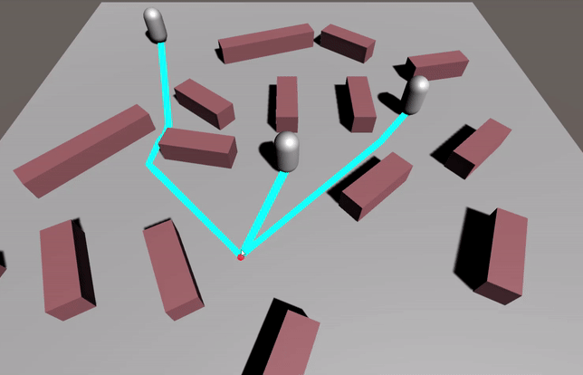
Unity Example: iDTech_NavMesh
Class Repository: github.com/hullabaloo-vincent/iDTech

Slide 3
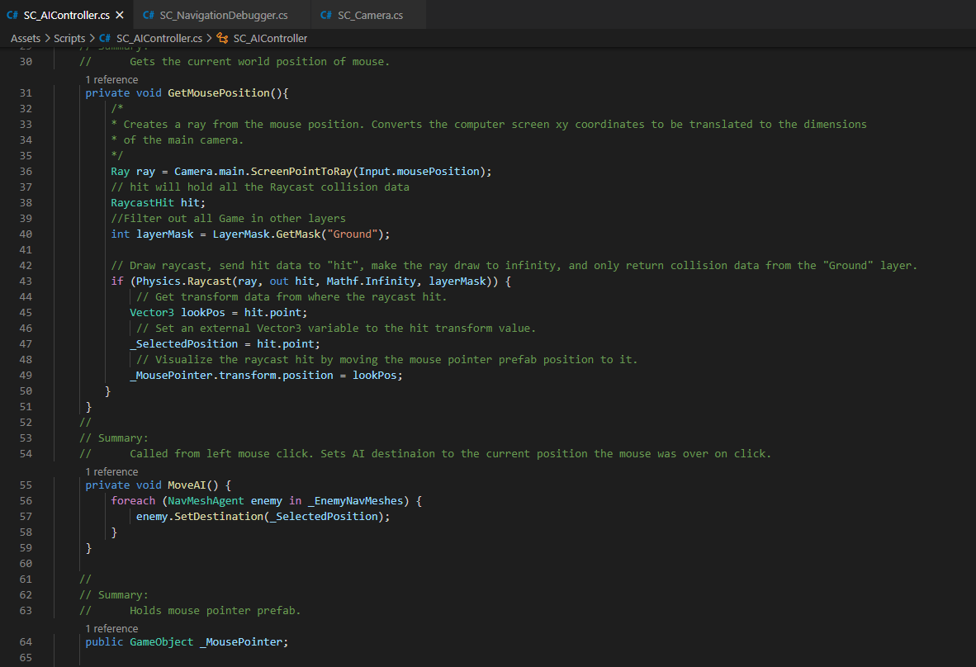
Unity Example: iDTech_NavMesh
Commented Code!

Slide 4
Pathfinding Heuristics in Video Games
A breakdown of the A* pathfinding system
*Heuristic = Method

Slide 5
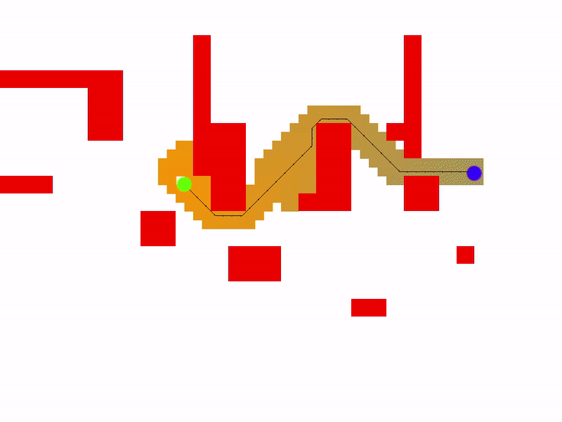
Custom A* Pathfinding System written in Game Maker Studio

Slide 6
Math
You need to know:
Distance between two coordinates
Simple addition
Linear Interpolation (encouraged)
C# Distance 3D Coordinates Example:
public static float Distance(Vector3 a, Vector3 b) {
Vector3 vector = new Vector3(a.x - b.x, a.y - b.y, a.z - b.z);
return Mathf.Sqrt(vector.x * vector.x + vector.y * vector.y + vector.z * vector.z);
}
Linear Interpolation
(x1, y1)
(x2, y2)

Slide 7
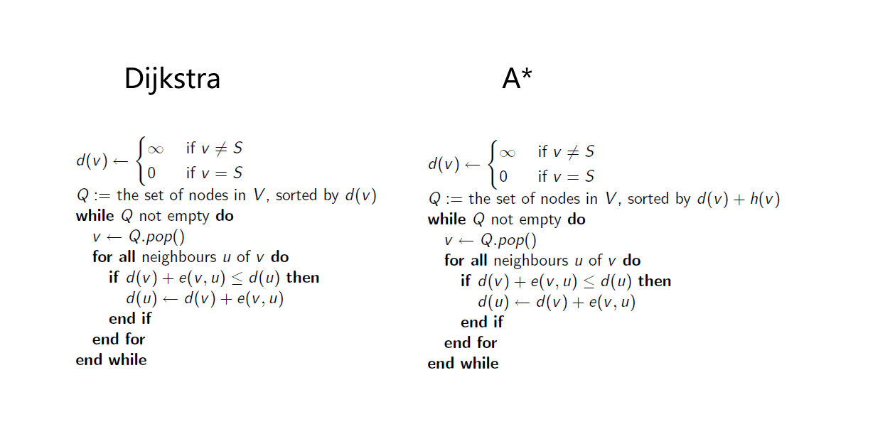
Pseudocode

Slide 8
Pseudocode
S = Start
T = End
v = node 1
u = node 2
Q = node queue
h(v) = distance from v to T
d(v) = distance from v to S
e(v, u) = edge distance from u to v
Node weight = h(v) + d(v)

Slide 9
Visually, How Does This Work?
(x1, y1)
(x2, y2)
+
Scost
weight
+
Ecost
node
start
end

Slide 10
Visually, How Does This Work?

Slide 11
Visually, How Does This Work?

Slide 12
Visually, How Does This Work?

Slide 13
Visually, How Does This Work?
It can search this way too. Promising nodes can change based on what it discovers.

Slide 14
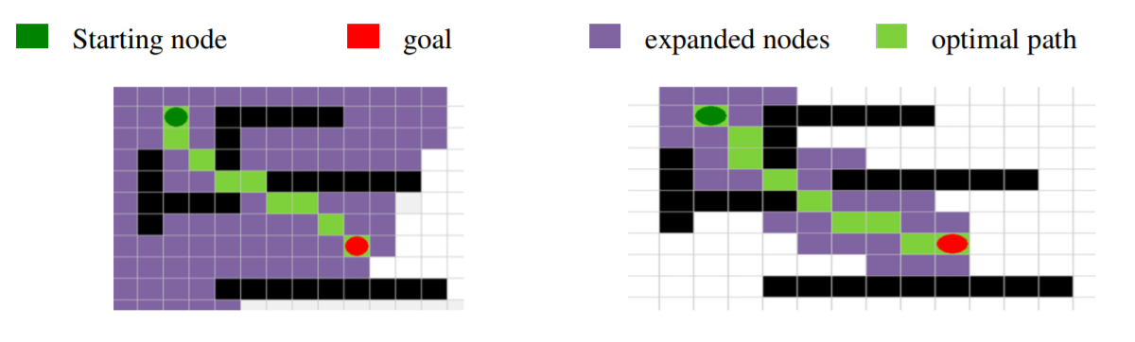
Why Not Dijkstra?
Image Source:
https://pdfs.semanticscholar.org/1e92/858a275c37c0e2b94c3ad280014bf810f12e.pdf

Slide 15
Why Not Dijkstra?

Slide 16
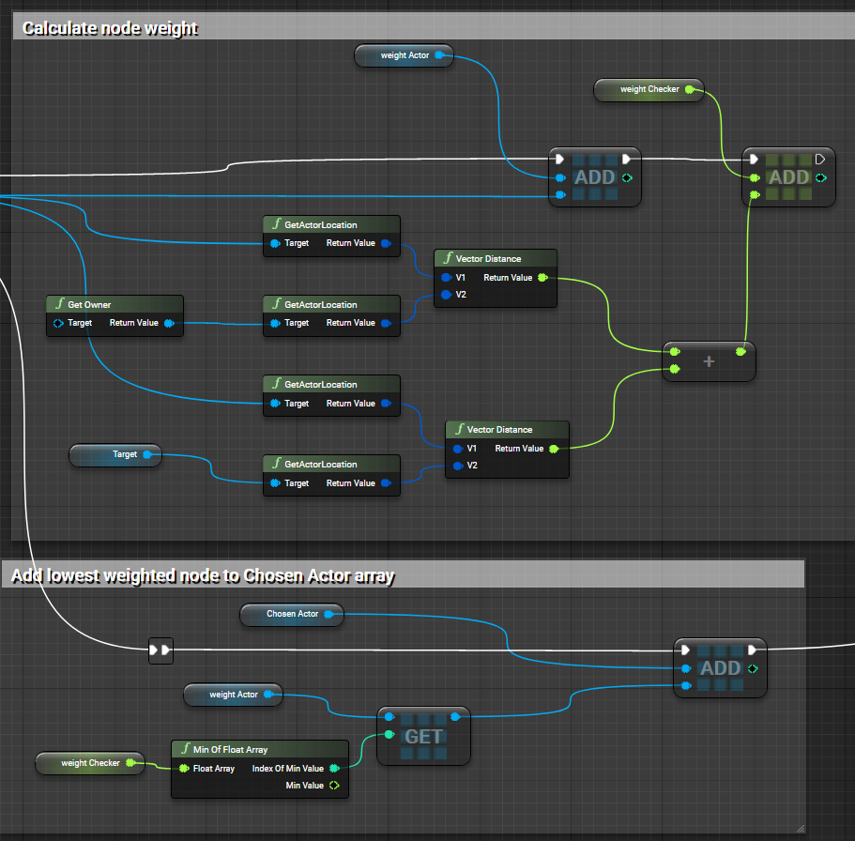
Visual Logic in Unreal
The logic is so versatile you could easily recreate it in Unreal
View BluePrint here:
https://blueprintue.com/render/8u3fksyu/

Slide 17
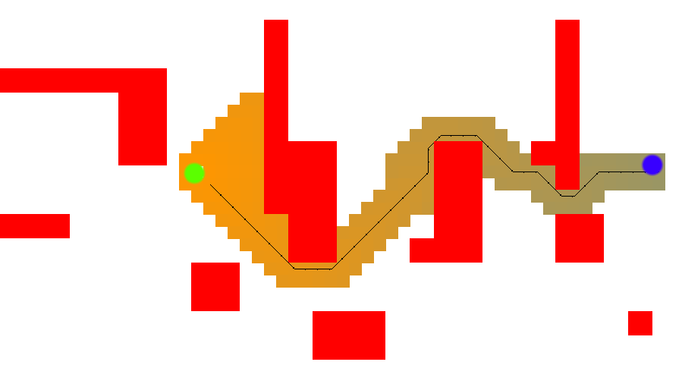
In Unity, the NavMesh returns “waypoints”, called corners. This is an array of coordinates where the AI must change directions.
5
6
4
8
11
3
7
9
10
Chosen Nodes with lowest weight
1
2
Waypoints

Slide 18
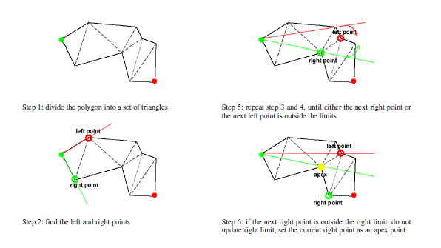
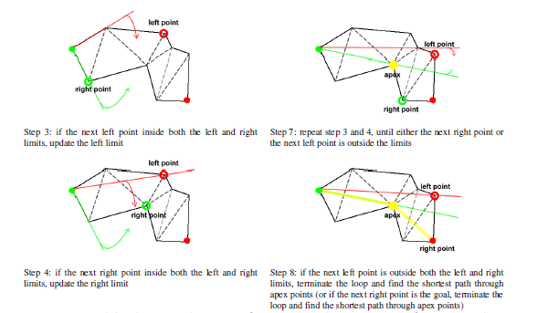
NavMesh
More effective way of splitting up a map using convex polygons
Still uses A*
Mostly used in 3D game but can still be applied to 2D.
Image Source:
https://pdfs.semanticscholar.org/1e92/858a275c37c0e2b94c3ad280014bf810f12e.pdf

Slide 19


Slide 20
Unity Example: iDTech_NavMesh
Class Repository: github.com/hullabaloo-vincent/iDTech

